Slide 1
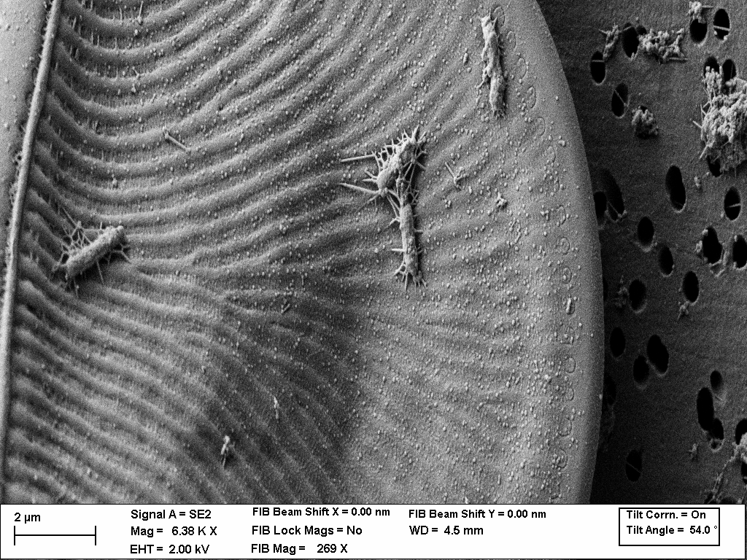

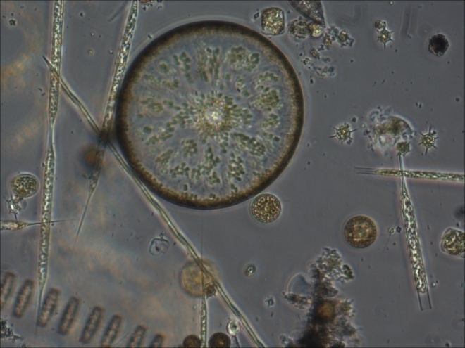
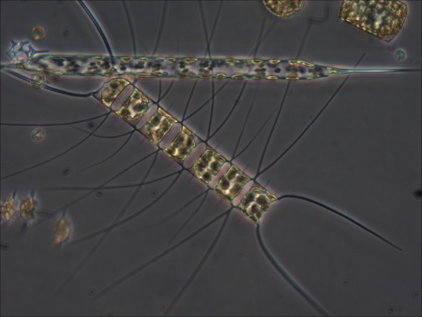
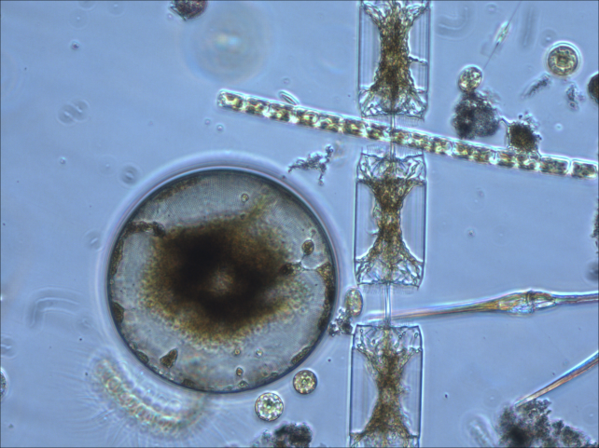
New Insights from Standardized Quantitative Methodology for Environmental and Functional
Genomics Studies of Marine Eukaryotic Microbes.
Andrew E. Allen

Slide 2
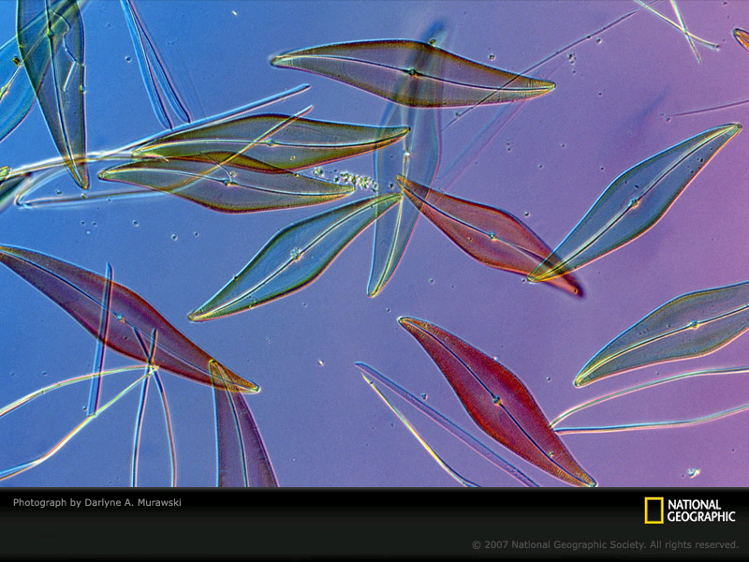
Allen Laboratory
(Ecophyisoloy and Evolutionary Genomics of Phytoplankton)
Wet Lab Functional Genomics
(Reverse/Forward Genetics, Physiology, Biochemistry, Transcriptomics , ChIP-Seq, Laboratory Evolution, Epigenetics)
Computational Biology/Informatics
Field Studies
(Distribution, Diversity, Metabolic Activity of Marine Microbes, Upwelling, Sub-Tropical Gyres, Polar Environments, Gulf of Mexico, California Current)

Slide 3
Research Questions
What are the evolutionary origins and ecological significance of physiological
and niche defining characteristics
(inheritance/endosymbiosis, lateral gene transfer,
genome evolution, transposons, sexual cycles, viruses)
What are the key regulators of carbon and nitrogen
metabolism and metabolic flux in marine phytoplankton
(carbon, nitrogen, phosphorous, silica, iron and other metals, vitamins)

Slide 4
Vignettes
Ecological Genomics of Iron Utilization by Phytoplankton
Customized standards for amplicon studies
Quantitative metatranscriptomics
Phylogenetic profiling
Iron – the diatom ferric iron uptake mechanism
Artificial chromosomes for gene function studies

Slide 5
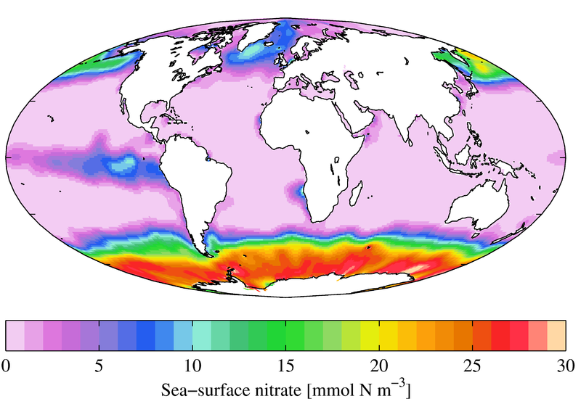
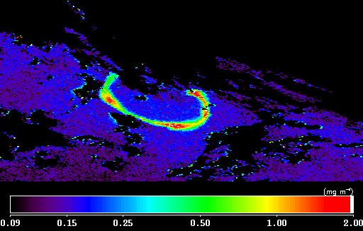
Lack of Iron Limits Phytoplankton Growth
Lack of iron limits primary productivity in many regions of the global ocean (‘HNLC’ regions)
Diatoms and other large phytoplankton are of the first organisms to respond to iron fertilization
We know very little about how these organisms acquire iron from the environment.
Iron fertilization visible from space (SOIREE expedition, 1999)

Slide 6
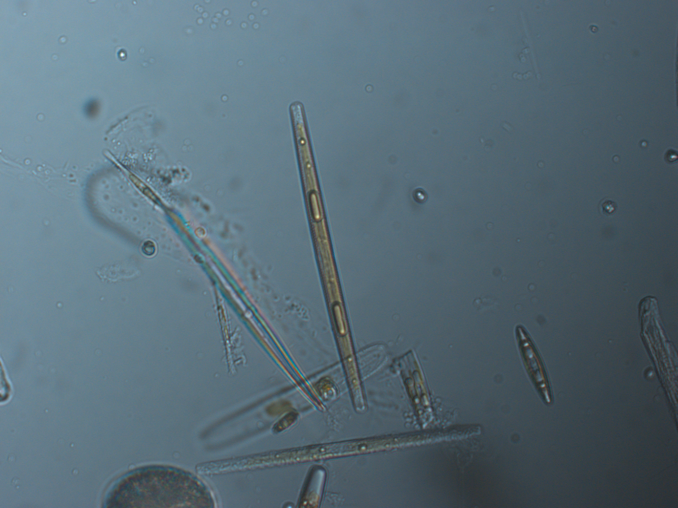
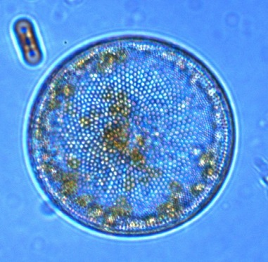
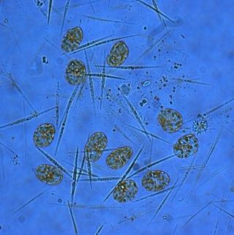
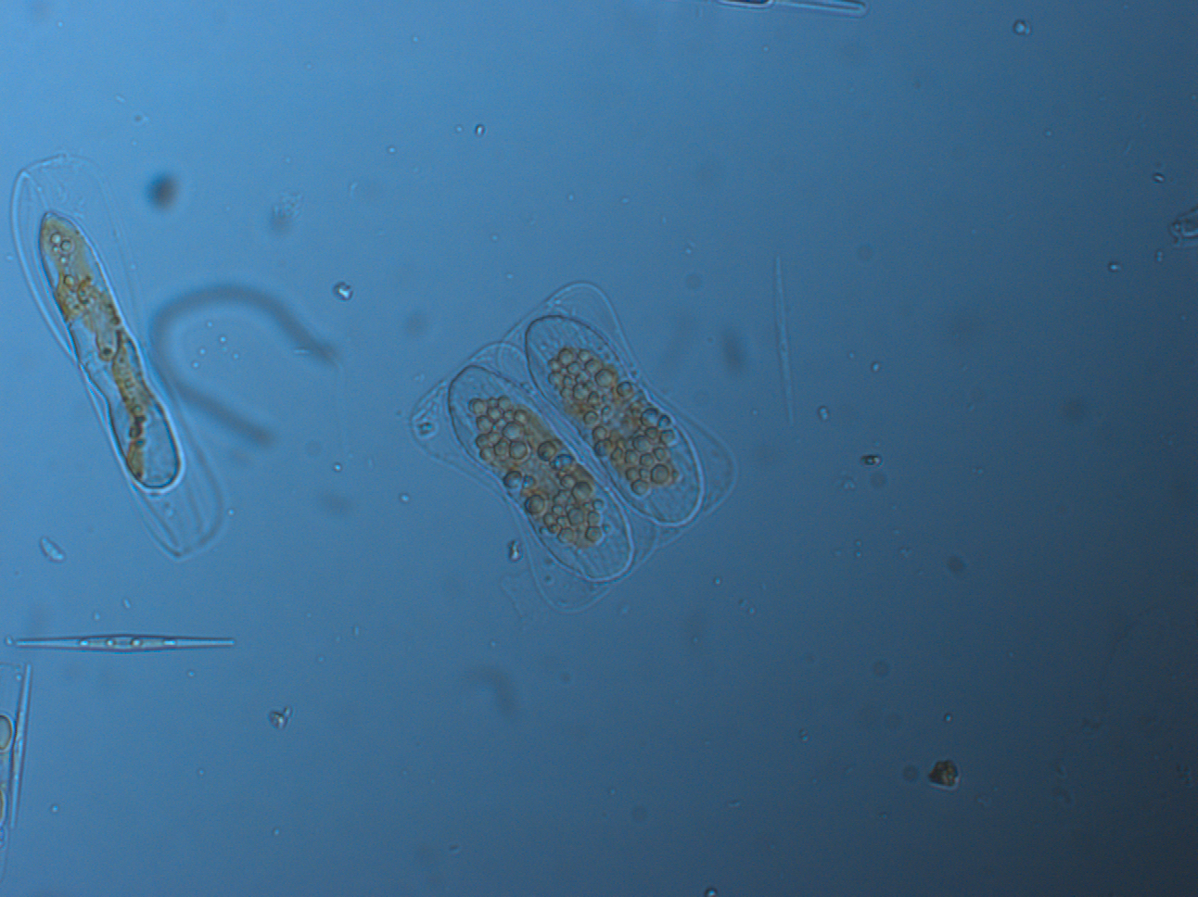
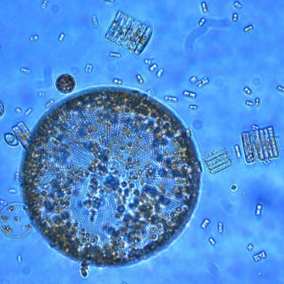
Change and projected change in the Ross Sea
Sea Surface Temperature:
Slight negative SST trend over past ~20-30 years; expected to continue 2-3 decades (Mayewski et al 2009, Comiso et al 2000, Lebedev 2007)
Then expected to warm substantially by the end of the next century (Bracegirdle and Stephenson, 2012); specific projections difficult (Smith et al 2014)
Iron:
Relative magnitude of sources still unclear
Shelf sediments, dust, sea ice
Result: change is likely but difficult to predict- direction and magnitude
(Smith et al 2012, 2014)
Change is coming: understand transcriptional baselines, response of existing communities
Photos: Jeff McQuaid, Dawn Moran

Slide 7
18S rRNA (V4) Mock Community Standards
Collaboration with Jed Fuhrman (USC)

Slide 8
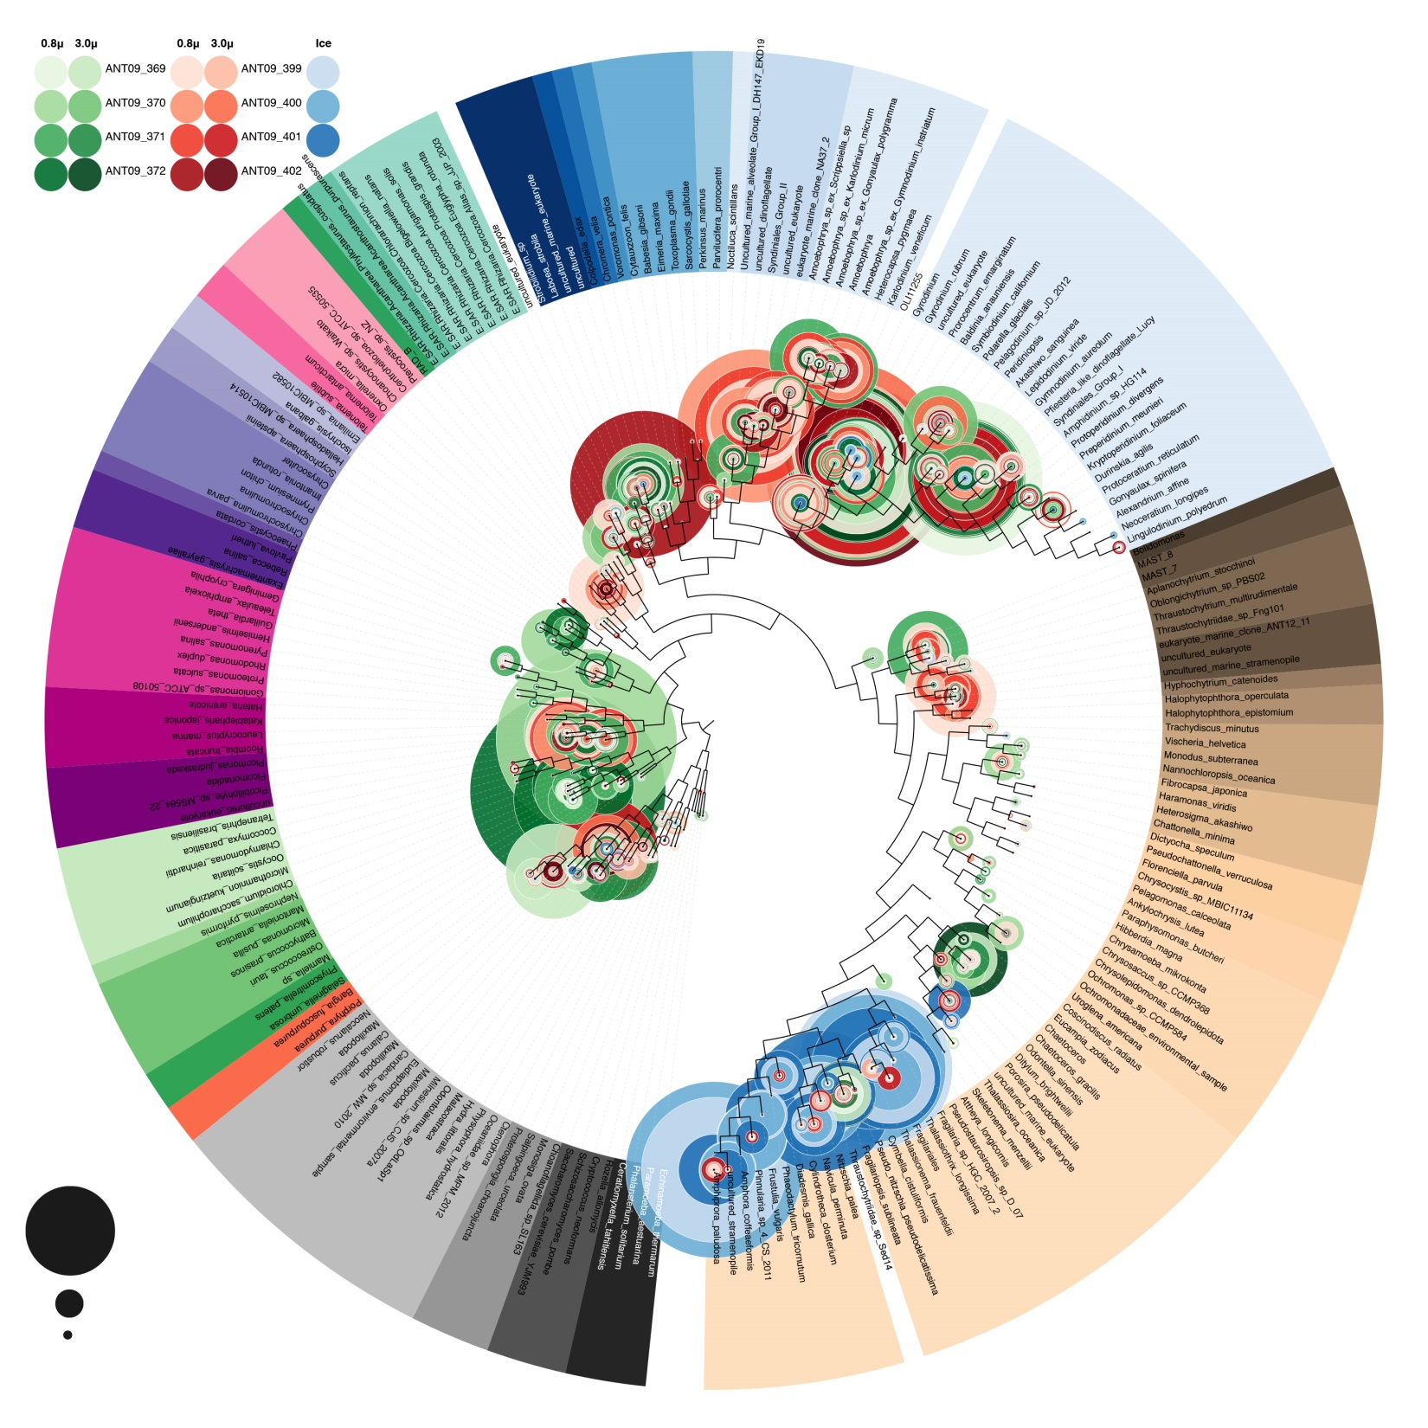
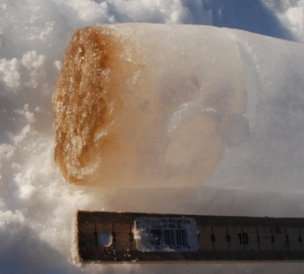
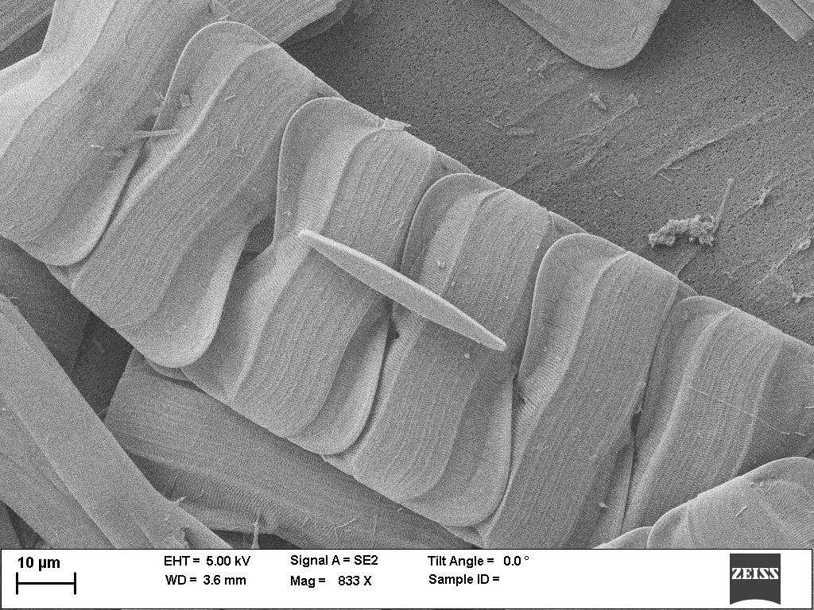
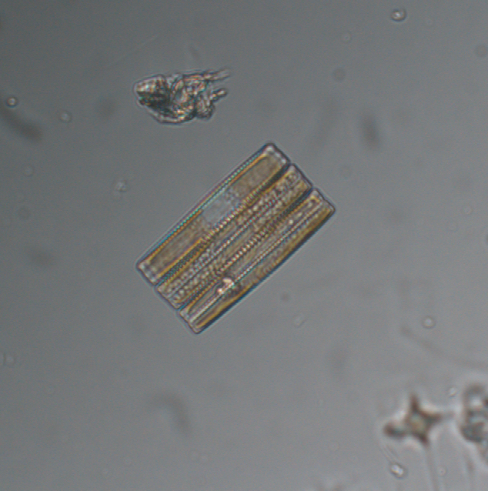
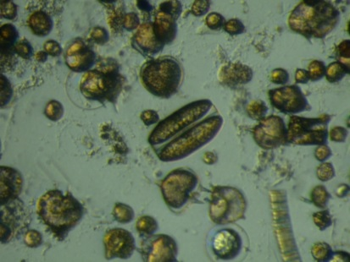
_{Ice}
18S rRNA analysis of Spring and Summer water column and sea ice McMurdo Sound communities
_{Jan}
_{Nov}
Alveolata
Haptophyta
Cryptophyta
Chlorophyta
10%
Opisthokonta
1%
Diatoms
Dawn Moran, Jeff McQuaid, Greg Wanger
0.1%
Saito Lab, WHOI
Ahmed Moustafa, JCVI, AUC Egypt

Slide 9
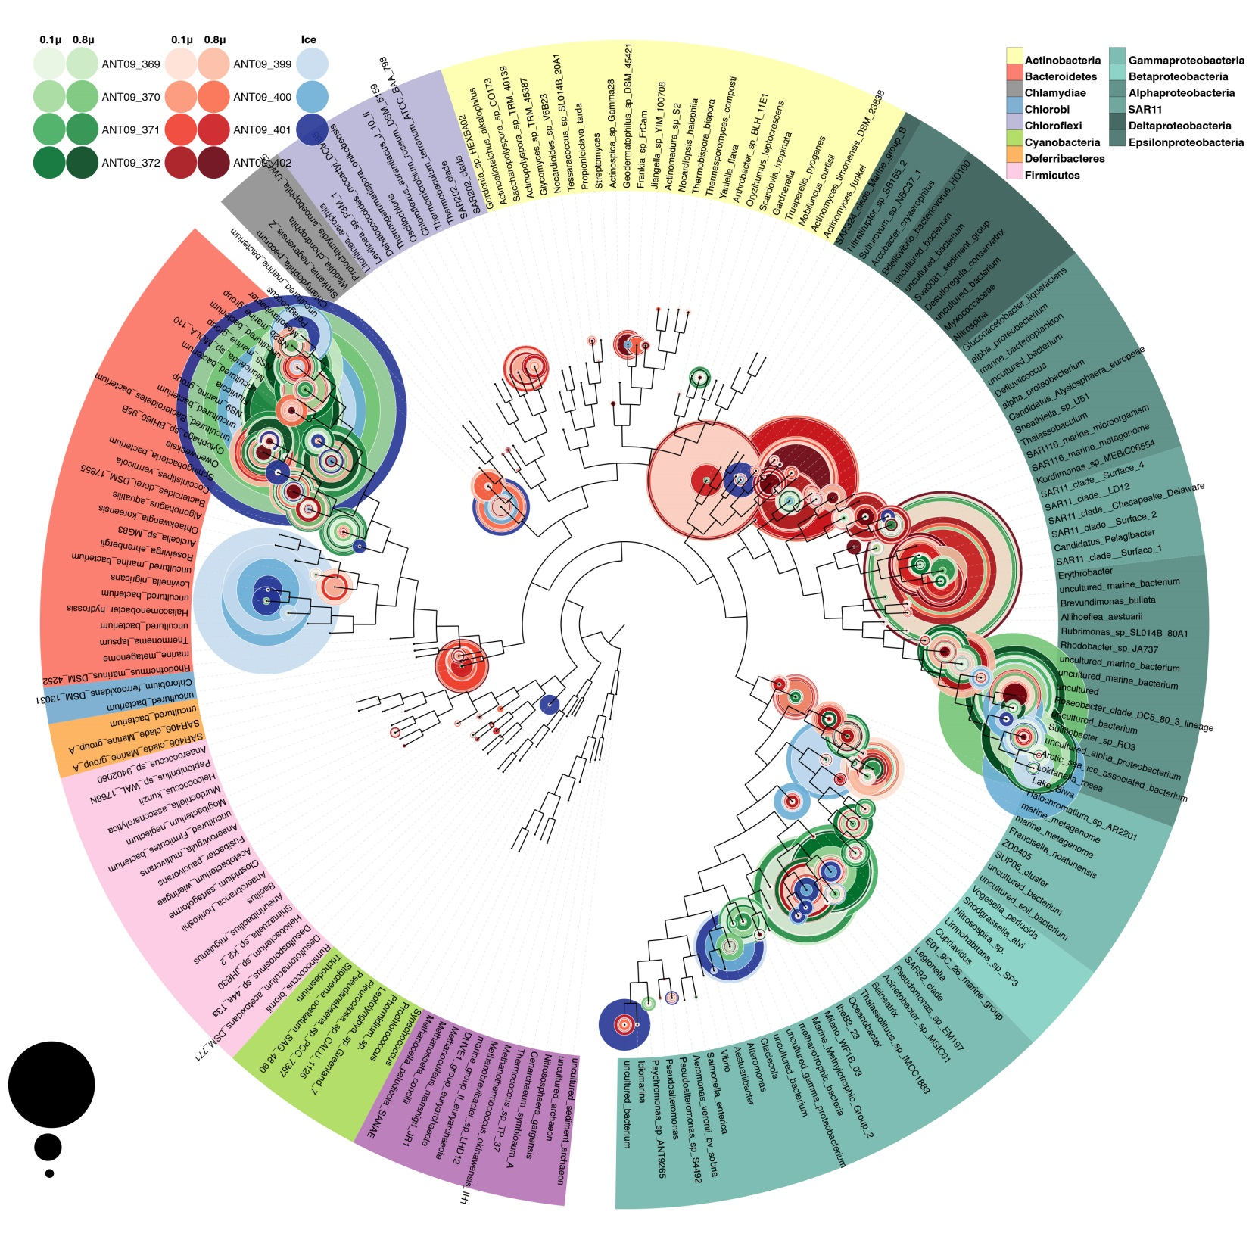
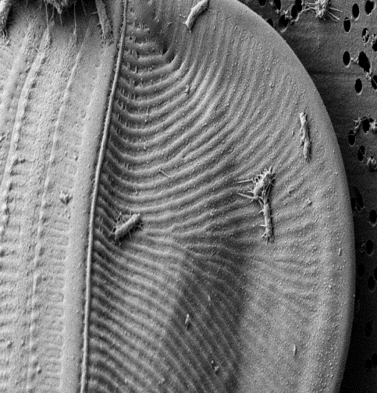
Ice
16S rRNA analysis of Spring and Summer water column McMurdo Sound communities
Jan
Nov
CFB
Alphaproteobacteria
2 µm
Sea Ice diatom and bacteria
(Greg Wanger)
Gammaproteobacteria
Saito Lab, WHOI
Ahmed Moustafa, JCVI, AUC Egypt

Slide 10
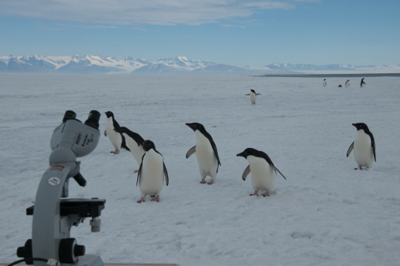
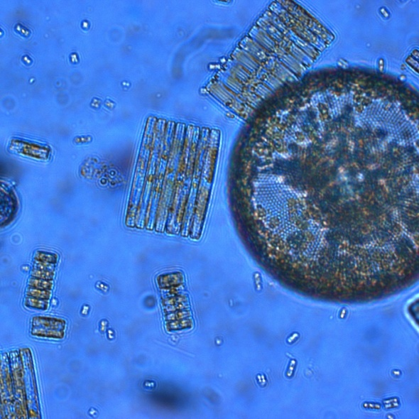
Question: What is the transcriptional response of McMurdo Sound phytoplankton and bacterial communities to changes in temperature, iron, and vitamin B₁₂ availability?
Approach: Manipulative experiments, late summer McMurdo Sound of the Ross Sea, Jan 2013
Photos: Erin Bertrand, Jeff McQuaid

Slide 11
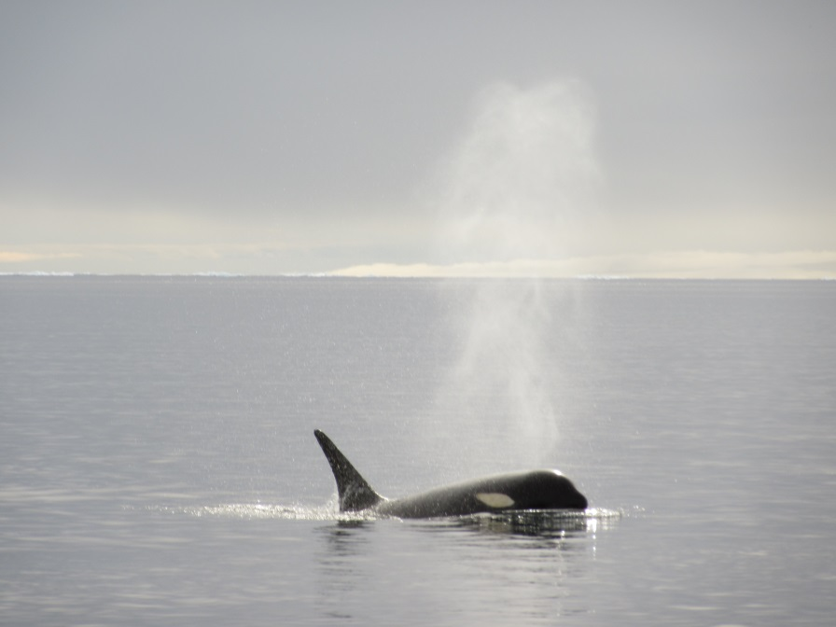
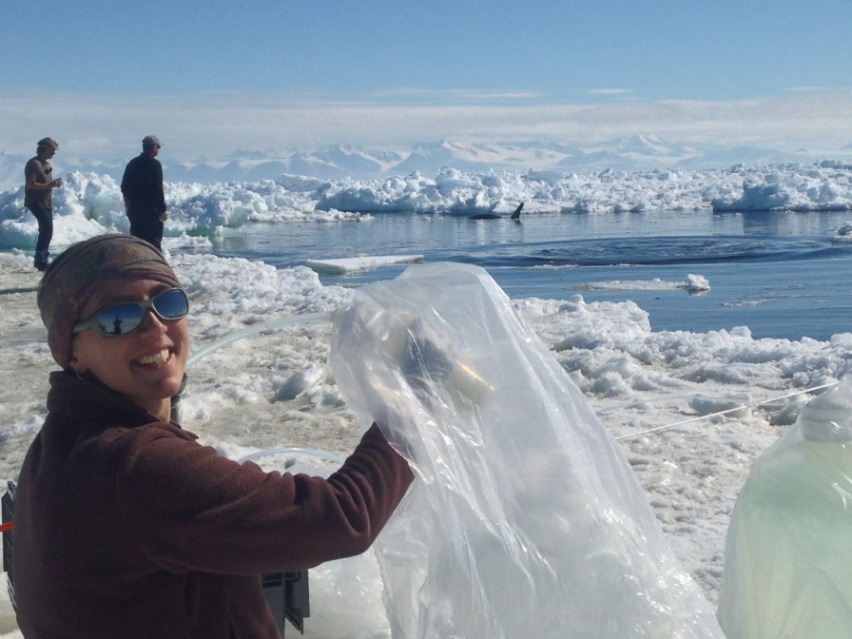

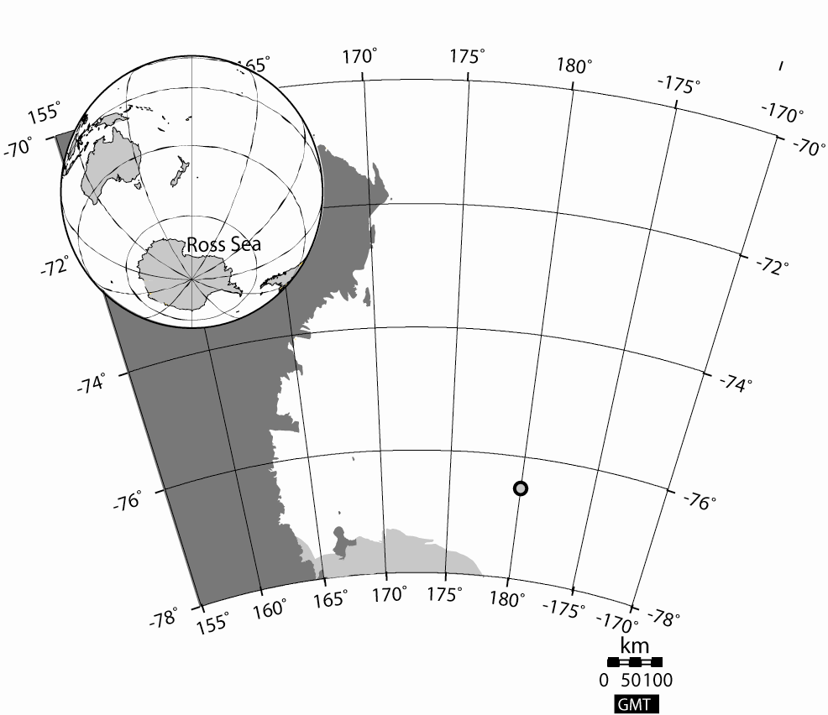

McMurdo Sound of the Ross Sea, late austral summer 2012/13
Erin Bertrand
Ross Island
16 Jan 2013: Collect 1000 L trace metal clean seawater; return via helicopter to McMurdo Station, Crary Lab
MODIS
Three types of manipulative experiments
Short term batch- manipulate Fe, B₁₂
Semicontinuous dilution- manipulate temperature, Fe
Continuous flow- “ecostats”- manipulate temperature, Fe, CO₂

Slide 12
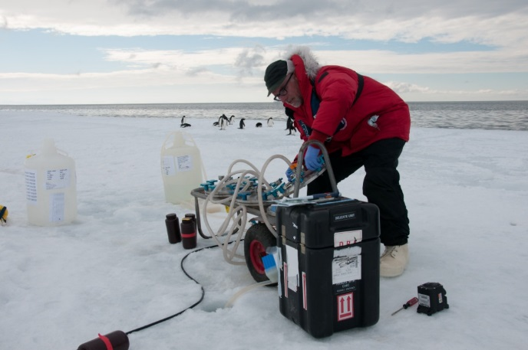
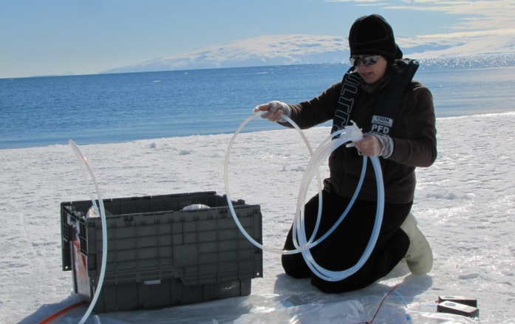
Short term bioassays: B₁₂ and iron
Characterize transcriptional response of initial community to micronutrient additions at 0°C
1 nM FeCl3, 200 pM B₁₂
Incubate 0°C, 24h
RNA samples
Nitrate, bicarbonate uptake (Bronk Lab)
Chla measure
After 96h, Chla measure
Control
+B₁₂
+Fe
+B₁₂Fe
Fill 2.7 L bottles and supplement
Harvest trace metal clean seawater, return to Crary Lab
Photos: Jen Erxleben
Bertrand et al., PNAS (2015)

Slide 13
Short term bioassays: B₁₂ and iron
Chlorophyll a at 96h:
community was independently B₁₂ and Fe limited
At 24h: Nitrate uptake rate increased in +Fe
treatments
No change in chlorophyll a or primary
productivity
Sequence community RNA after 24 hours rRNA removal to enrich mRNA
target bacteria and phytoplankton
Bronk Lab (VIMS)
Bertrand et al., PNAS (2015)

Slide 14
Metatranscriptome analysis pipeline
Sample collection
RNA extraction
Library prep
Sequencing
200-2000 mL filtered onto
0.2 um cartridge filters
and cleanup plus rRNA removal
NuGen cDNA synthesis and Truseq library preparation
Paired end Illumina
Hiseq 2000
Targets Bacteria, Archaea, Eukaryotic nuclear and organelle mRNA
Read Filtering
Assembly
ORF Calling
PhyloDB Annotation
Filtering of primers, adapters, rRNA; quality trimming
Combined assembly by merging in stages
(CLC de novo)
Prediction of ORFs on assembled contigs and further filtering of rRNA
(1)Taxonomy via best blast hit
(2) functional domains (PFams/TIGRFams), KEGG, KOG, GO, EC, pathway, transporter and transmembrane domains, organelle assignment
PhyloDB:
25 million peptide sequences
Does not rely on blast hit for functional annotation
MMETSP transcriptome sequencing included

Slide 15
Sequencing and assembly summary
Pooled libraries
 | Reads | ORFS
Raw | 441,425,648
Trimmed | 414,698,752
Mapped | 299,185,770
rRNA | 21,624,539
Assigned | 171,783,433 | 194,173
Eukaryotes | 141,024,961 | 136,144
Bacteria | 28,424,075 | 56,031
Archaea | 214,737 | 245
Virus | 954,416 | 1096
Unknown phylogeny | 1,165,244 | 657
Assigned Reads:
82% eukaryotic
16% bacterial
Percent of trimmed reads
Bertrand et al., PNAS (2015)

Slide 16
Eukaryotic Taxonomic Composition
Bertrand et al., PNAS (2015)

Slide 17
Eukaryotic taxonomic composition between treatments
Bertrand et al., PNAS (2015)

Slide 18
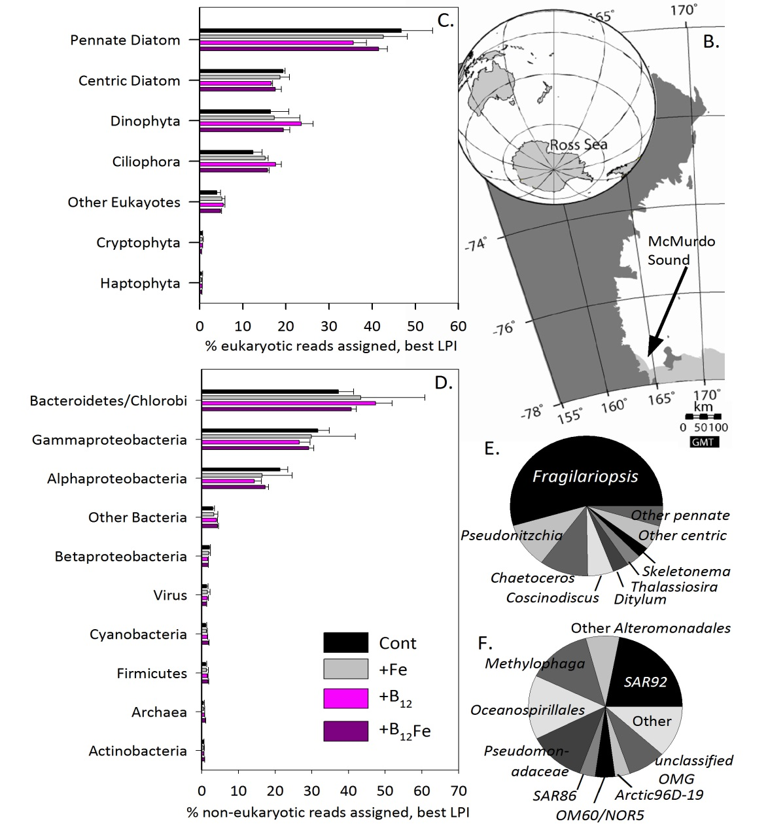

Community contributions to mRNA pool
Fragilariopsis- dominated diatom community, no significant differences: Transcriptome differences reflect changes in gene expression levels within the community, NOT community composition changes
Bertrand et al., PNAS (2015)

Slide 19

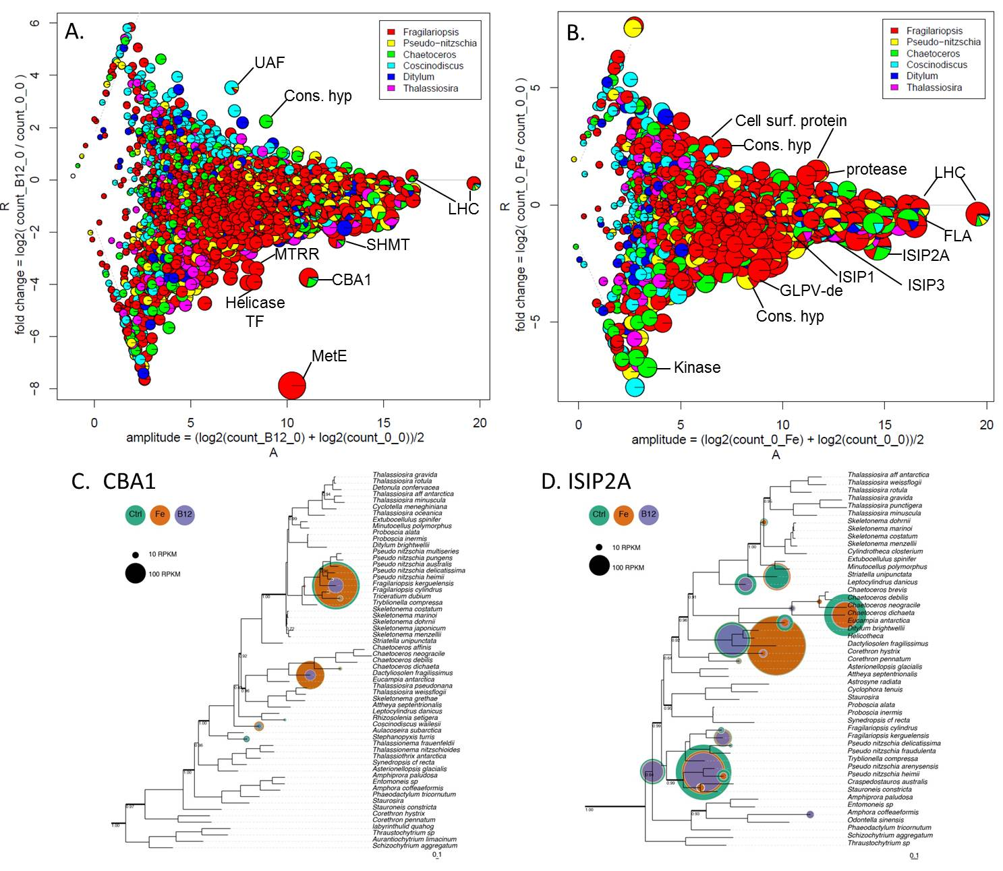
Global View: Differential Transcript Abundance Patterns in Diatoms 24 h After Micronutrient Addition
Transcripts encoding proteins that manage Fe and B12 starvation are repressed 24 hrs after Fe or B12 addition
Control Fe
ISIP2A 2 ± 7 x 10⁷ copies L⁻¹ 3 ±2 x 10⁶ copies L⁻¹
Control B12
CBA1 9 ± 4 x 10⁷ copies L⁻¹ 2 ± 0.4 x 10⁷ copies L⁻¹
MetE 3 ± 1 x 10⁸ copies L⁻¹ 6 ± 0.4 x 10⁶ copies L⁻¹
Relatively high expression of these two genes in unamended control samples suggests cobalamin stress in the natural community
Bertrand et al. PNAS (2015)

Slide 20
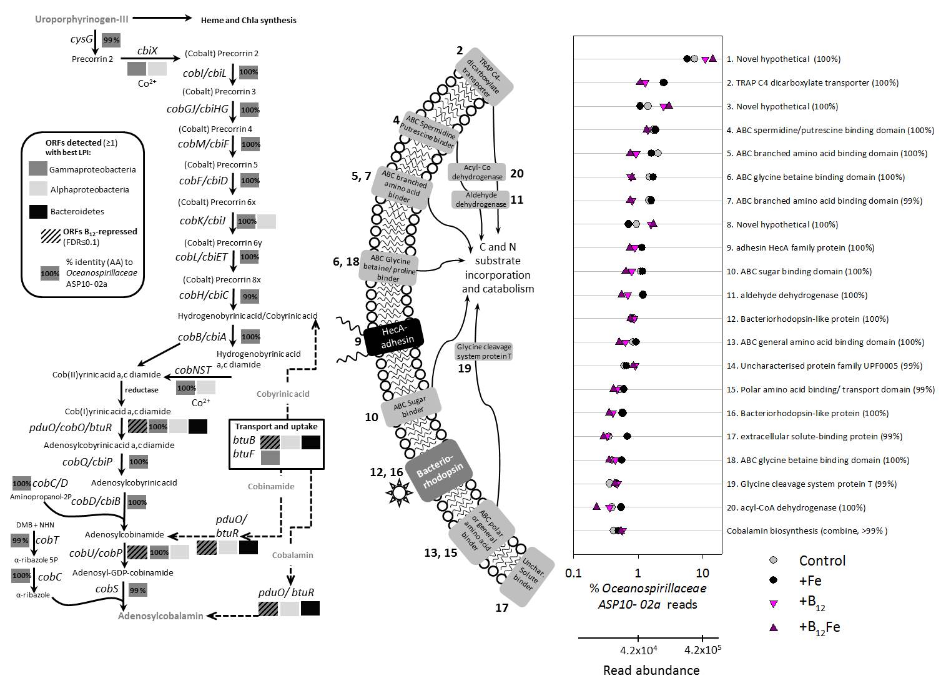
Cobalamin biosynthesis and uptake pathway
Many ORFs showed at least 99% similarity to sequences from the Oceanospirillaceae
ASP10-02a population
Reads mapping to the Oceanospirillaceae ASP10-02a metagenomic assembly represent 70% of all
reads mapping to the cobalamin biosynthesis pathway
(ASP10-02a assembly from Southern Ocean polynya community courtesy of Anton Post and Tom Delmont)
Bertrand et al. PNAS (2015)

Slide 21
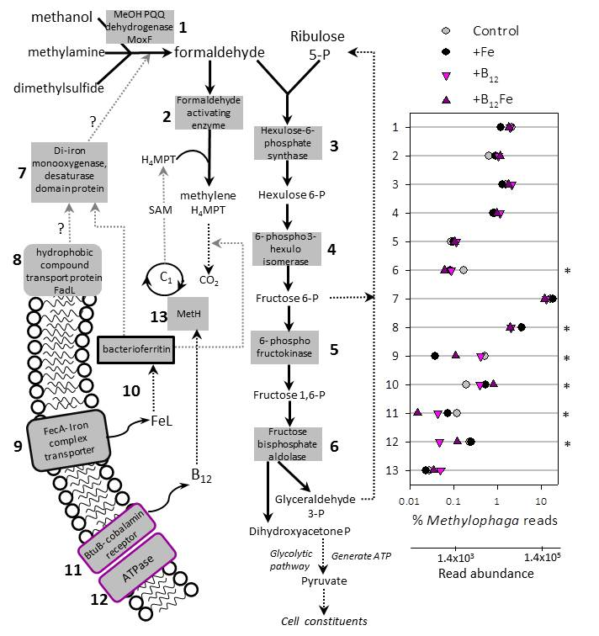
Abundant ORFs assigned to Methylophaga sp. (A dominant, cobalamin-consuming bacterial group; possible connections to cobalamin and Fe responsive ORFs)
Methanol is a ubiquitous, abundant phytoplankton waste product. This gammaproteobacterial group uses the ribulose monophosphate pathway for C1 compound assimilation to couple increased phytoplankton growth, via diatom methanol production, to enhanced competition for cobalamin and iron
(Methylophaga shows signatures for Fe and B12 deprivation. Transcripts encoding Fe and B12 uptake proteins are repressed upon Fe and B12 addition respectively)
Bertrand et al. PNAS (2015)

Slide 22
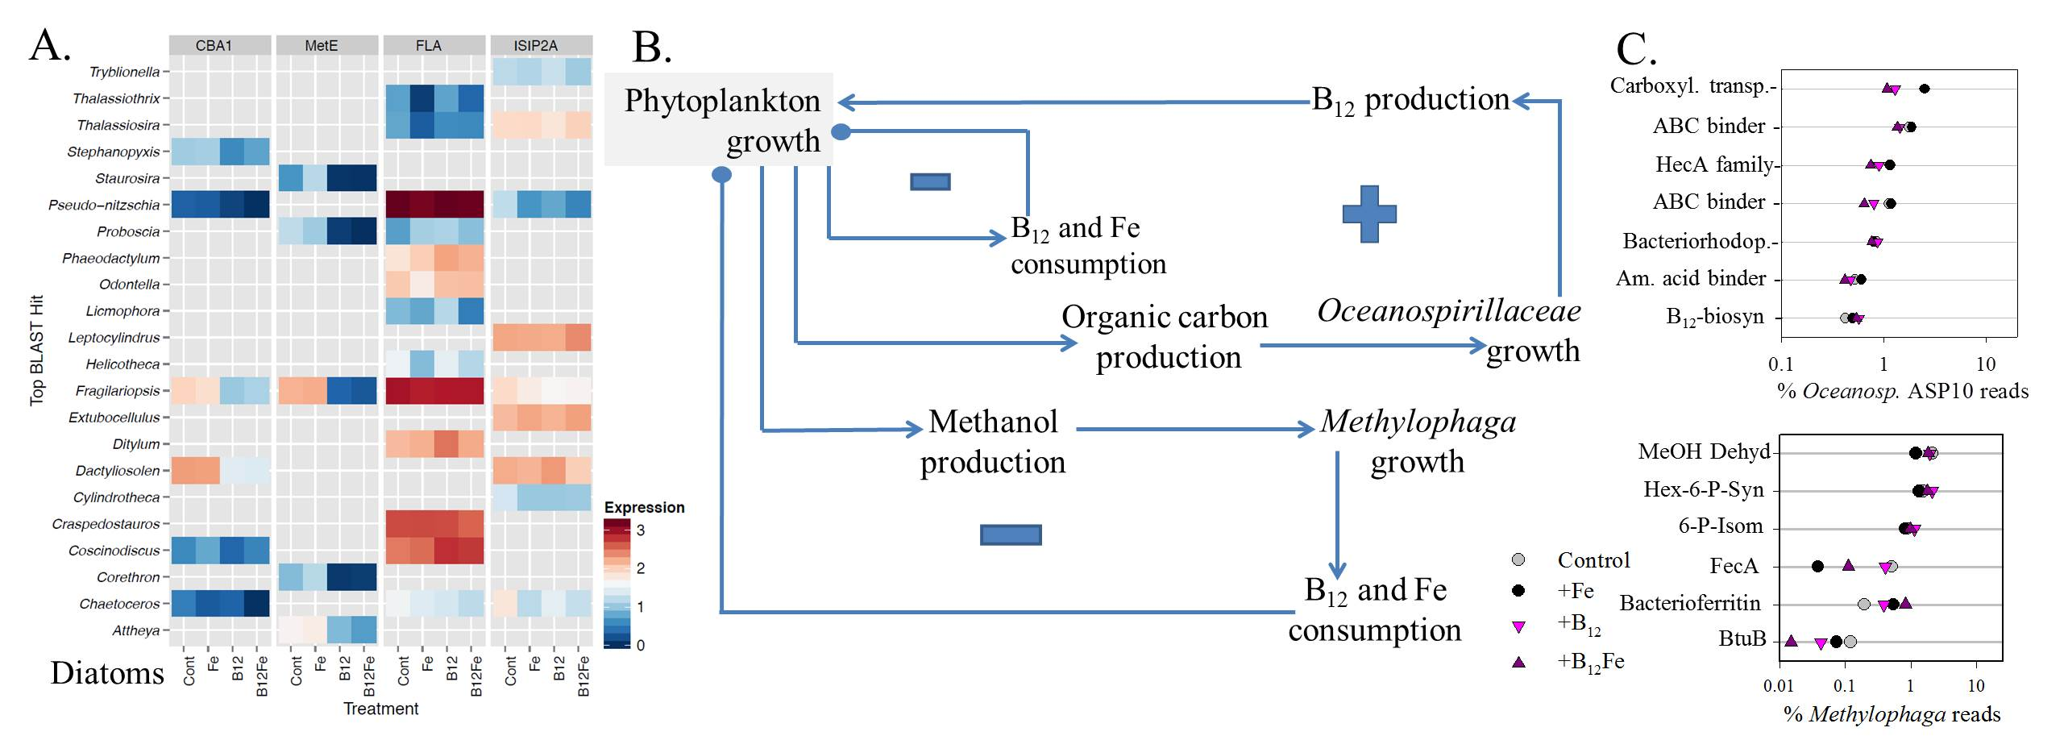
Feedback loops, driven by phytoplankton-bacterial coupling, appear to control interactivity of cobalamin and iron dynamics
In a positive feedback loop, cobalamin production increases as a result of enhanced phytoplankton-derived
organic matter production, providing a mechanism for further increasing phytoplankton growth.
This may be counterbalanced by negative feedback loops in which phytoplankton and bacterial
(e.g. Methylophaga) demand for cobalamin increase as a result of enhanced phytoplankton productivity
and bacterial salvage and repair of degraded cobalamin is reduced upon increased in cobalamin supply.
Bertrand et al. PNAS (2015)

Slide 23
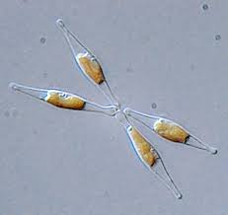
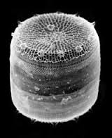
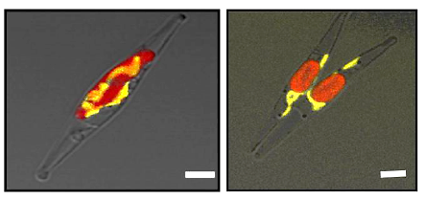
Diatom Molecular Tools
Genetic transformation and manipulation
Model diatom species: P. tricornutum and T. pseudonana
examples: Fluorescent protein localization, Gene silencing/knockouts
Allen et al. 2011
Limitations:
Inefficient DNA delivery methods (e.g. biolistic particle delivery):
labor and cost intensive
Inconsistencies due to random and/or fragmented genomic integration
No autonomous replicating plasmid
more consistent expression, better control of expression vectors
ability to remove from line

Slide 24
Conjugation-based DNA delivery to P. tricornutum using a two-plasmid system
Allows Cargo Plasmid to transfer
Conjugative Plasmid
60 kb
OriT
Cargo Plasmid
6-16 kb
Cargo
ShBle
(Pt selectable Marker)
E. coli
P. tricornutum
Karas et al. (2015) Designer diatom episomes delivered by bacterial conjugation. Nature Communications
Notes:
To transform Pt, we used a two plasmid system including both a conjugative and cargo plasmid. If both plasmids contain an origin of transfer, they will both be transferred to the recipient. We used the conjugative plasmid pRL443, which contains an origin of transfer and all conjugative machinery, but does not contain elements required for replication in Pt, so it would not be maintained as an autonomous plasmid. If the E.coli contains another plasmid with an origin of transfer, that plasmid will also be transferred. In the case of p0521s, which contains the yeast elements enabling replication, the plasmid can then be maintained in Pt. The plasmid can then be used to express genes of interest (which we have demonstrated)

Slide 25
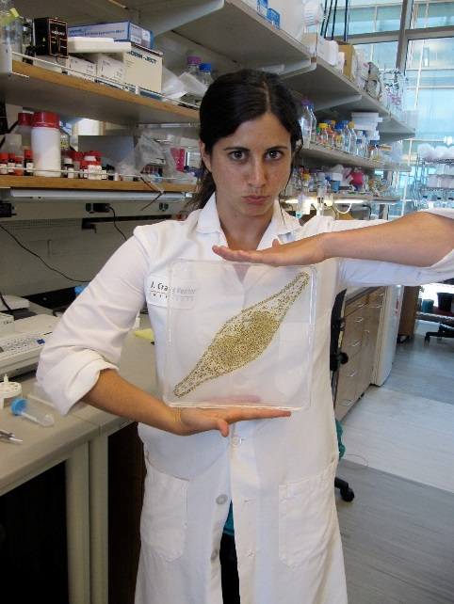
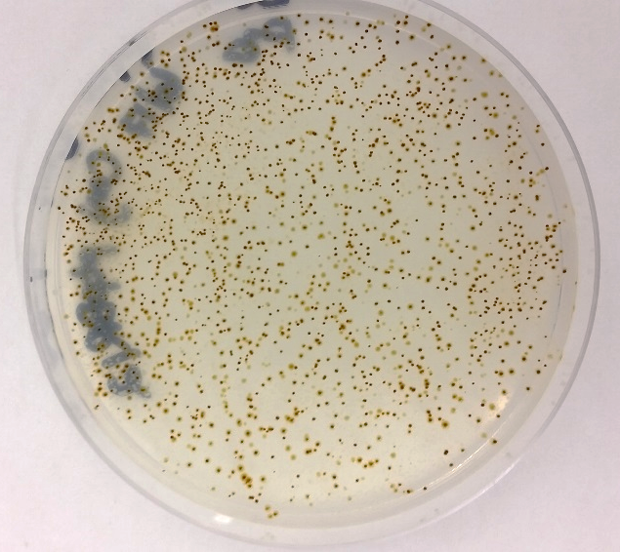
High transformation efficiency via bacterial conjugation
Optimal Method (see Karas et al. 2015 for specific protocols):
1hr 30min at 30°C
Specific concentration of E. coli and Pt cells
Re-plate on selection after 2 days
Karas et al. Nature Communications (2015)

Slide 26
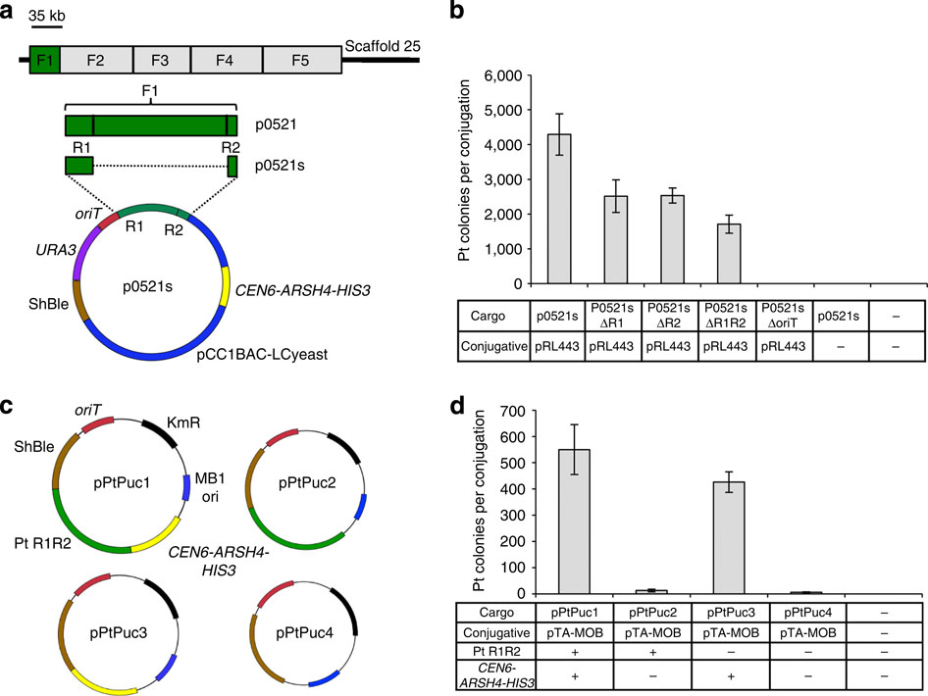
High plasmid delivery efficiency via bacterial conjugation
Cargo Plasmid
+
+
+_{(No OriT})
+
+
-
-
-
Conjugative Plasmid
Diatoms P. tricornutum and T. pseudonana
and the bacterium E. coli
Plasmid extraction from diatom
recovery
E. coli transformation
verification
Plasmid-safe
Gel imaging
Stability/Copy #
Karas et al. Nature Communications (2015)

Slide 27
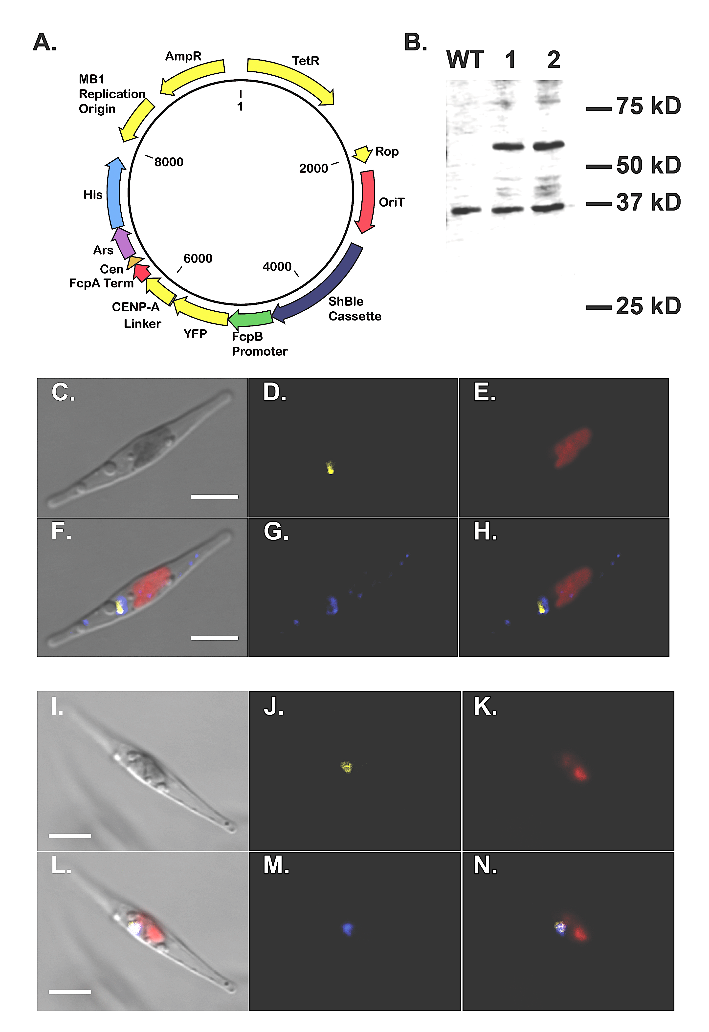
ChIP-seq to identify diatom centromeres
Confirmation
ChIP-seq
Localization and Western Blot
Precipitate
using anti-GFP
Purify DNA
Sequence
Protocol modified from Lin et al. 2012
Diner et al. PNAS (2017)

Slide 28
Chromosome “breakdown”: Low GC diatom sequences maintain episomes. Centromeres?
25 Low GC centromeres and the foreign yeast DNA sequence recruit CENP-A
All nuclear centromeres contain a 500-bp region of <33% GC content
(vs. 47% genome average)
No similarities between sequences!
Diner et al. PNAS (2017)

Slide 29
Low GC “rule” mostly holds up. Exceptions have fewer contiguous A/T regions
Diner et al. PNAS (2017)

Slide 30
What does this mean for phytoplankton-bacteria interactions?
Transgene delivery tool!
Marine bacteria for delivery?
Bacterial conjugation may be a foreign gene delivery mechanism (plasmids, ICE’s?).
Does this actually happen? How often? Consequences?
Very common sequences with low GC content can enable nuclear gene acquisition through “hijacking” replication machinery
Intracellular or extracellular nuclear DNA acquisition
Probably most common between organelles and nuclear genome

Slide 31

Diatoms have a high affinity for ‘free’ ferric iron
Most iron in the ocean is complexed – very little free iron
However diatom growth is most influenced by conc. of [Fe’]
Anderson and Morel (1982) estimated the affinity of a diatom for [Fe’] at 10¹⁹ M⁻¹
Only known iron binding protein with an affinity that high are transferrins
Diatom community, Ross Sea
(J. McQuaid)

Slide 32

Transferrins are high-affinity Fe binding proteins
Transferrins: a metazoan trick
Used for inter-cellular trans-port and iron sequestration
Transferrin proteins have very high affinities for iron: Kd = 10²² M⁻¹
Iron-loaded transferrin is internalized via receptor mediated endocytosis
Transferrin affinity altered by pH changes in the endosome
Hypothesized there must be a ‘phytotransferrin’ equivalent

Slide 33
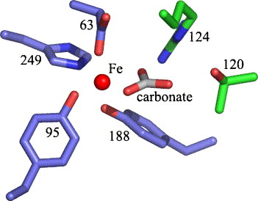
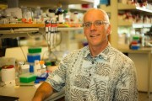
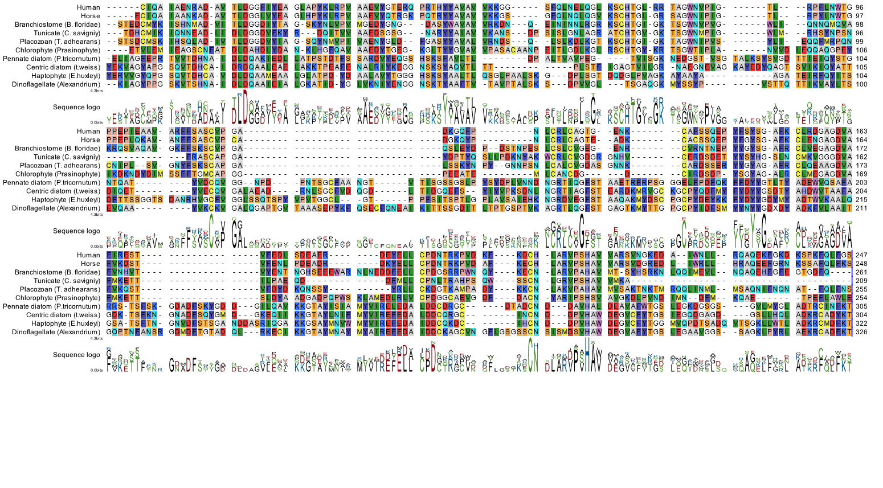
Alignment of metazoan transferrins and phytoplankton ISIP2a proteins
Canonical iron binding residues conserved --
protein not so much…
Iron coordinating residues
Metal coordinating residues, human transferrin (Lambert et al, 2005)
Jeff McQuaid, SIO/JCVI
Carbonate coordinating residues

Slide 34
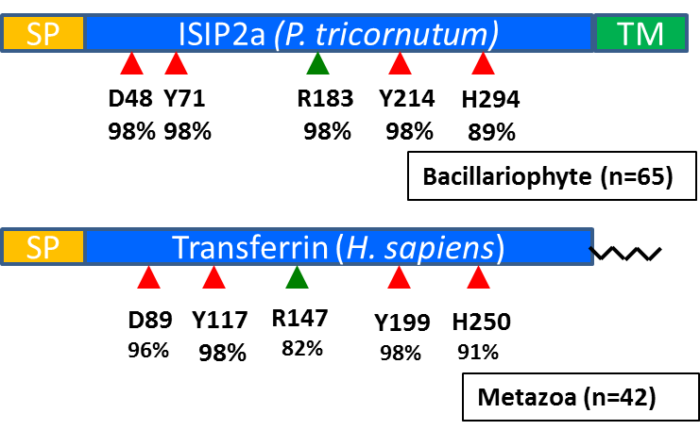
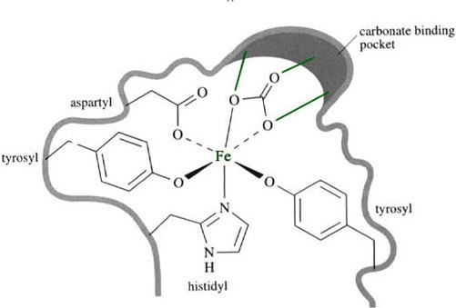
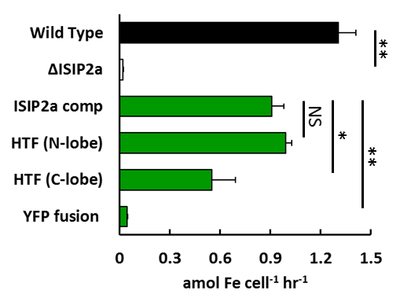
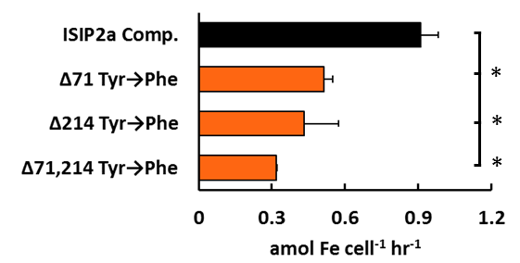

Biochemistry Part I: Complementation and Mutagenesis
Complementing with human TF
Knockout had 90% loss of function
Synthesized and fused hTF to ISIP2a TM-region and Signal Peptide
Human TF restored high affinity uptake (15 pM ⁵⁹Fe′)
Site Directed Mutagenesis
Changed active site tryosines to phenylalanined and complemented
All showed reduction in binding
McQuaid et al. Nature (2018)
Notes:
Already have a head start: pM affinity.

Slide 35
Biochemistry Part I: Complementation and Mutagenesis
Complementing with human TF
Knockout had 90% loss of function
Synthesized and fused hTF to ISIP2a TM-region and Signal Peptide
Human TF restored high affinity uptake (15 pM ⁵⁹Fe′)
Site Directed Mutagenesis
Changed active site tryosines to phenylalanined and complemented
All showed reduction in binding
McQuaid et al. Nature (2018)
Notes:
Already have a head start: pM affinity.

Slide 36
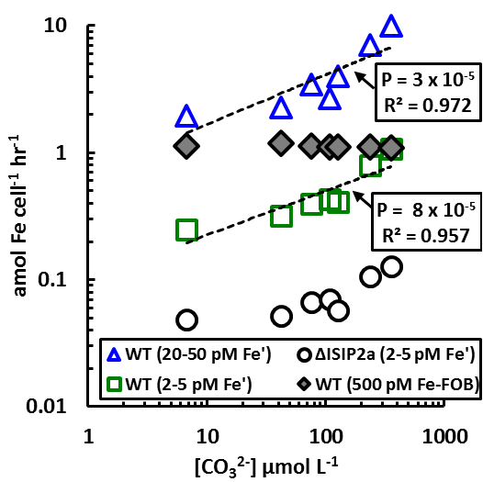
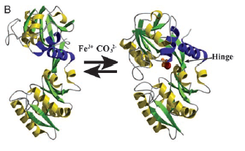
Biochemistry Part III: What about carbonate?
In human transferrin, CO₃²⁻ functions as a synergistic anion:
Neither iron nor CO₃²⁻ bind in absence of the other
Total carbon manipulation during short-term ⁵⁹Fe uptake
pH constant: minimizes changes in Fe:EDTA dissociation
Linear response to uptake at low/high Fe’ concentration
Iron siderophore uptake unaffected by [CO₃²⁻]
Note ∆ISIP2a still shows some response to CO₃²⁻
Linear across current and projected seawater [CO₃²⁻]
Data can be expressed as a product of [Fe′][CO₃²⁻]
ANOVA interaction effects significant (p = 2 x 10⁻⁶)
[Fe′][CO₃²⁻] product fits a linear model across all [Fe′]
Second order rate dependence is hallmark of transferrin
Implies that [CO₃²⁻] limits the uptake of Fe′!
(At right): transferrin
‘sampling’ iron, note
movement around hinge
McQuaid et al. Nature (2018)

Slide 37
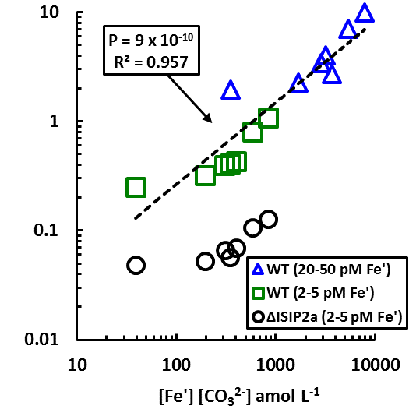
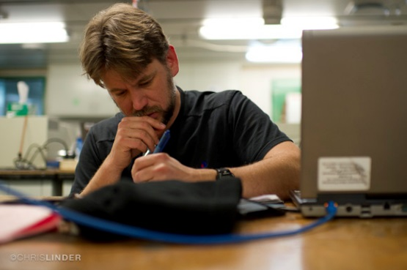
Biochemistry Part III: What about carbonate?
In human transferrin, CO₃²⁻ functions as a synergistic anion:
Neither iron nor CO₃²⁻ bind in absence of the other
Total carbon manipulation during short-term ⁵⁹Fe uptake
pH constant: minimizes changes in Fe:EDTA dissociation
Linear response to uptake at low/high Fe’ concentration
Iron siderophore uptake unaffected by [CO₃²⁻]
Note ∆ISIP2a still shows some response to CO₃²⁻
Linear across current and projected seawater [CO₃²⁻]
Data can be expressed as a product of [Fe′][CO₃²⁻]
ANOVA interaction effects significant (p = 2 x 10⁻⁶)
[Fe′][CO₃²⁻] product fits a linear model across all [Fe′]
Second order rate dependence is hallmark of transferrin
Implies that [CO₃²⁻] limits the uptake of Fe′!
First order rate constants
Fe′: 0.782 ± 0.05
CO₃²⁻: 0.00156 ± 0.00087
McQuaid et al. Nature (2018)
Adam Kustka, Rutgers

Slide 38
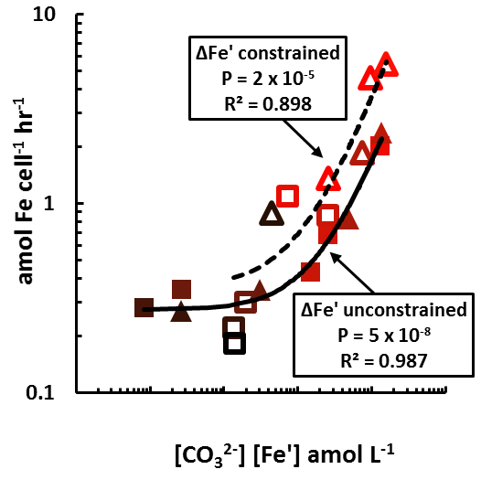

Biochemistry Part IV: manipulating the seawater carbonic acid system through pH/pCO₂
Simplified seawater carbonate
CO₂ + H₂O + CO₃²⁻ = 2HCO₃⁻
Manipulating CO₃²⁻ via pCO₂
Both Fe′ and CO₃²⁻ covary
FeEDTA dissociation rate is 2.5x the change in CO₃²⁻
Bubbled 50 – 5000ppm CO₂, generating a range of [Fe′], [CO₃²⁻] and pH values
[Fe′][CO₃²⁻] product linear
Synergistic interaction still explained data
[ISIP2a] increased with pCO2: responding to Fe′ or CO₃²⁻
When ∆Fe′ is constrained, effect is the same
Here, [ISIP2a] is responding to the change in CO₃²⁻
Implies that changes in pCO2 can induce iron limitation
McQuaid et al. Nature (2018)

Slide 39

Biochemistry Part IV: pH/pCO₂ manipulation
Simplified seawater carbonate
CO₂ + H₂O + CO₃²⁻ = 2HCO₃⁻
Manipulating CO₃²⁻ via pCO₂
Both Fe′ and CO₃²⁻ covary
FeEDTA dissociation rate is 2.5x the change in CO₃²⁻
Bubbled 50 – 5000ppm CO₂, generating a range of [Fe′], [CO₃²⁻] and pH values
[Fe′][CO₃²⁻] product linear
Synergistic interaction still explained data
[ISIP2a] increased with pCO2: responding to Fe′ or CO₃²⁻
When ∆Fe′ is constrained, effect is the same
Here, [ISIP2a] is responding to the change in CO₃²⁻
Implies that changes in pCO₂ can induce iron limitation
pCO₂ (ppm)
McQuaid et al. Nature (2018)

Slide 40


Atmospheric CO₂ is rising! The oceans are acidifying! Diatom Fe’ uptake mechanisms are inhibited! Sad!
Southern Ocean
Drop in pH from 8.1 to 7.8 (400 to 800 ppm CO₂) would
decrease P. tricornutum uptake rates 44.5%
Changes iron bioavailability: tip areas into iron limitation?
Predicted changes in seawater carbonate ion through
Year 2100. Note intrinsically low [CO₃²⁻] in Southern Ocean

Slide 41

Summary and Conclusions
Diatoms, the dominant primary producers, displayed gene expression patterns unambiguously indicative of simultaneous iron and cobalamin deprivation.
The major cobalamin producer as a gammaproteobacterial population, Oceanospirillaceae ASP10-02a, which displayed elevated expression of organic matter acquisition and cell surface attachment genes, suggesting that they are dependent on phytoplankton growth to directly fuel coblalamin production.
In sum, Southern Ocean iron limitation may be better understood as possible micronutrient colimitation, with the nature and degree of that colimitation mediated by phytoplankton- bacterial interactions in both positive and negative feedback loops.

Slide 42

Summary and Conclusions
TALENS, bacterial conjugation, synthetic biology, and forward genetics
are powerful new components of the diatom biology tool kit.
ISIP2a is a phytotransferrin, a functional analog of transferrin which independently and convergently evolved carbonate-coordinated ferric iron binding. It is responsible for ferric iron uptake in seawater.
This synergistic interaction of [Fe′] and [CO₃²⁻] occurs across a range of environmentally relevant concentrations of seawater carbonate ion , suggesting that [CO₃²⁻] may co-limit Fe′ uptake.

Slide 43


Acknowledgements
Gone but not forgotten
Jeff McQuaid(JCVI/SIO)
Erin Bertrand (JCVI/SIO)
Rachel Diner (JCVI/SIO)
Bogumil Karas (JCVI)

Slide 44




Acknowledgements
John McCrow (JCVI)
Hong Zheng (JCVI)
Ariel Rabines (JCVI)
Kathy Barbeau (SIO)
Andreas Anderson (SIO)
Adam Kustka (Rutgers)
Miroslav Obornik (Czech Republic)
Dave Hutchins (USC)
Deborah Bronk (Bigelow)
Jed Fuhrman (USC)
Ahmed Moustafa (American University)
Mak Saito (Wood Hole Oceanographic)
Marine Microbiology Initiative
Biological Oceanography,
Molecular and Cellular Biology. Dimensions of Diversity, Office of Polar Programs
Biological and Environmental Research Program

Slide 45
Summary and Conclusions
Diatoms, the dominant primary producers, displayed gene expression patterns unambiguously indicative of simultaneous iron and cobalamin deprivation.
Chlorophyll production patterns support this and show that phytoplankton were concurrently limited by cobalamin and iron availability.
The major cobalamin producer as a gammaproteobacterial population, Oceanospirillaceae ASP10-02a, which displayed elevated expression of organic matter acquisition and cell surface attachment genes, suggesting that they are dependent on phytoplankton growth to directly fuel coblalamin production.

Slide 46
Summary and Conclusions
Separate bacterial groups, including Methylophaga, also rely on phytoplankton growth for carbon and energy sources and appear to be important cobalamin consumers, competing with phytoplankton for this resource and displaying gene expression patterns consistent with iron and cobalamin deprivation.
In sum, Southern Ocean iron limitation may be better understood as possible micronutrient colimitation, with the nature and degree of that colimitation mediated by phytoplankton- bacterial interactions in both positive and negative feedback loops.

